Slide 1
Shelbyfield Animal Rescue
Adoptable Pets

Slide 2
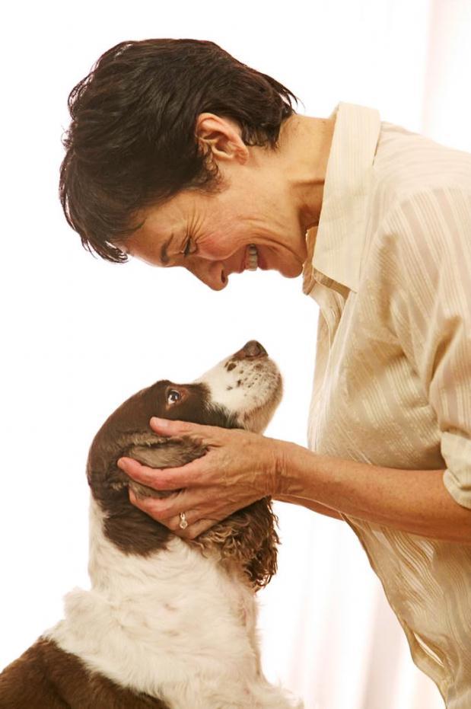
Mission
…to rescue, rehabilitate, and re-home stray or unwanted pets. Shelbyfield Animal Rescue dedicated to helping animals in need, and helping you find the perfect pet for your home.
Visit shelbyfieldrescue.com for more info

Slide 3
Man’s Best Friend
Adoptable Dogs

Slide 4

Franny
Female 30 lbs.
Whippet 5 yrs. old
Likes: Long walks on the beach
Dislikes: Drama

Slide 5

Zooey
Male 18 lbs.
Border Collie Mix 3 mos. old
Likes: Cookies
Dislikes: Fruits and vegetables

Slide 6
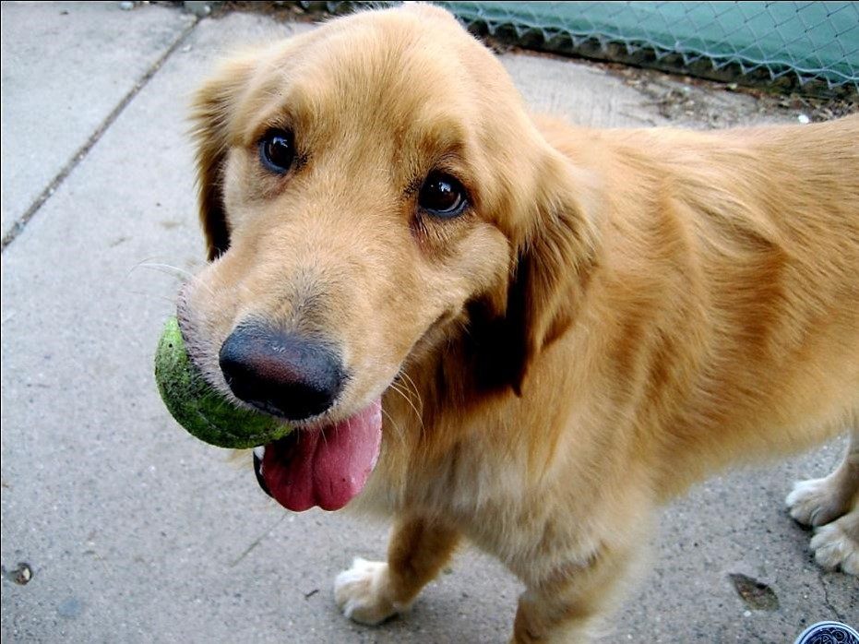
Salinger
Male 72 lbs.
Golden Retriever 3 yrs. old
Likes: Filthy tennis balls
Dislikes: Clean tennis balls

Slide 7
All Creatures Great and Small
Cats and Other
Adoptable Pets

Slide 8
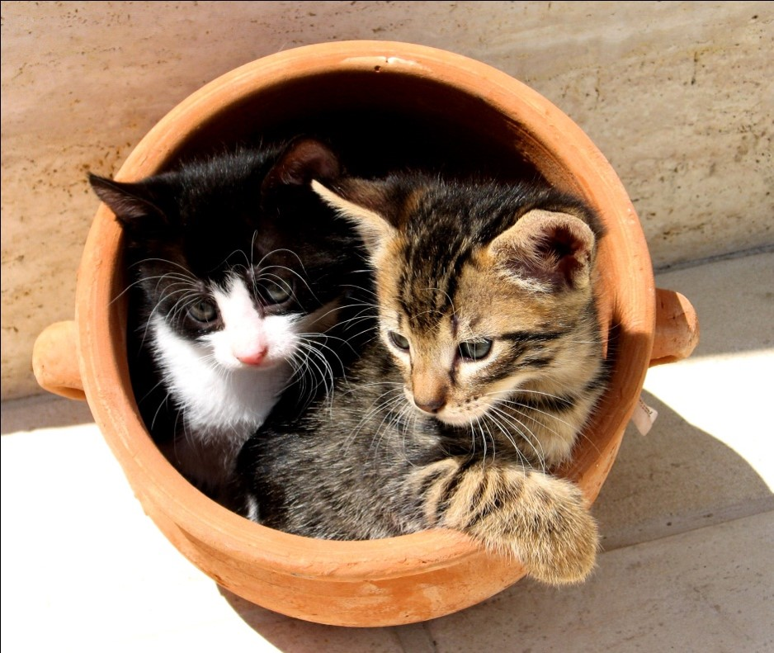
Khan & Bagheera
Male & Female 7 & 5 lbs.
Shorthair 6 mos. old
Likes: Clay pots
Dislikes: Pans

Slide 9
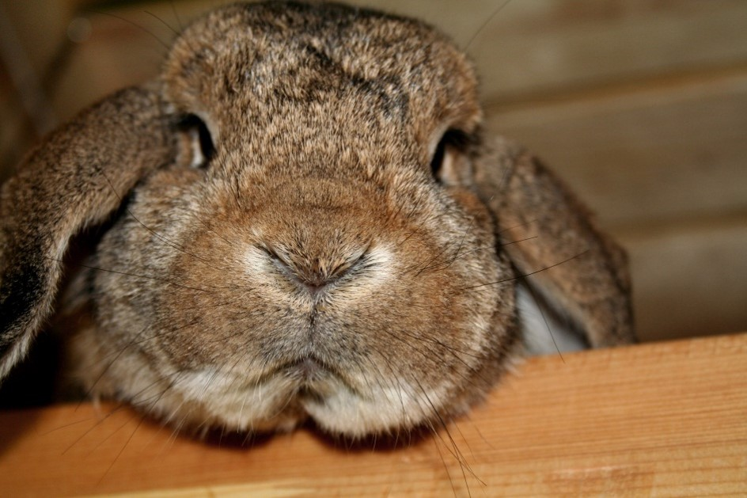
Beatrix
Female 10 lbs.
French Lop 2 yrs. old
Likes: Running
Dislikes: Losing to the tortoise

Slide 10
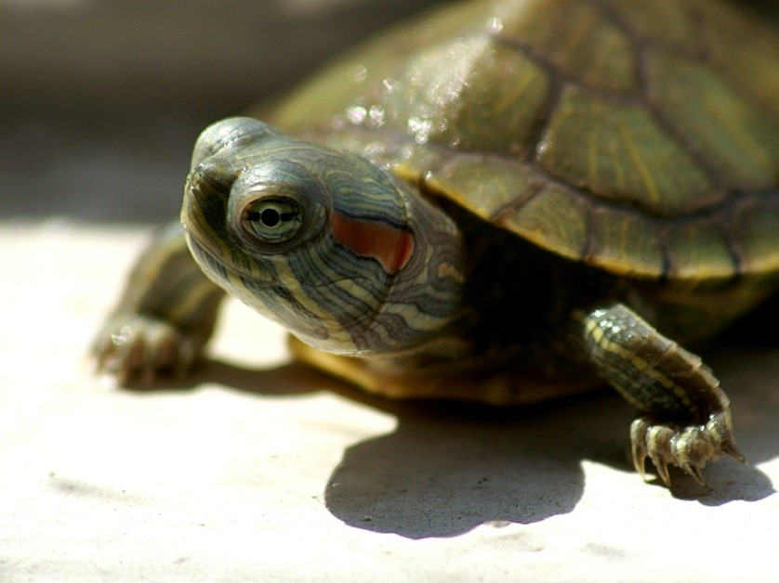
Donatello
Male 4 lbs.
Red-Eared Slider 1 yr. old
Likes: Pizza
Dislikes: Foot soldiers

Slide 11
All Warm and Fuzzy Inside
Benefits of Pet Ownership

Slide 12
Benefits of Pet Ownership
Stress relief
Lower blood pressure
Exercise
Companionship
Social opportunities

Slide 13
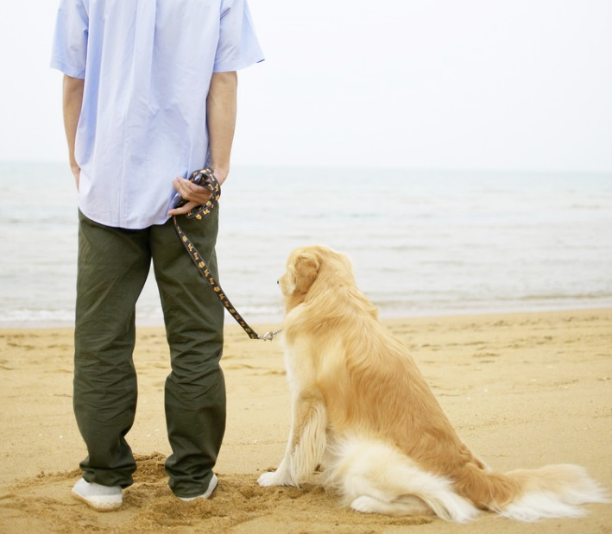
Contact Us
Visit shelbyfieldrescue.com for more adoptable pets!
Shelbyfield Animal Rescue
info@shelbyfieldrescue.com
321-555-3746
Shelter Hours
Monday – Saturday
10:00 AM – 6:00 PM

